Slide 1

Kwen Peterson https://github.com/Kwen/sfdevs
"You're already in the top tier of developers just by showing up here tonight. I don't know how talented you are, how much experience you have, but you showed up. You're putting yourself out there because you care to improve. Thanks for caring.“ – Scott Hanselman

Slide 2
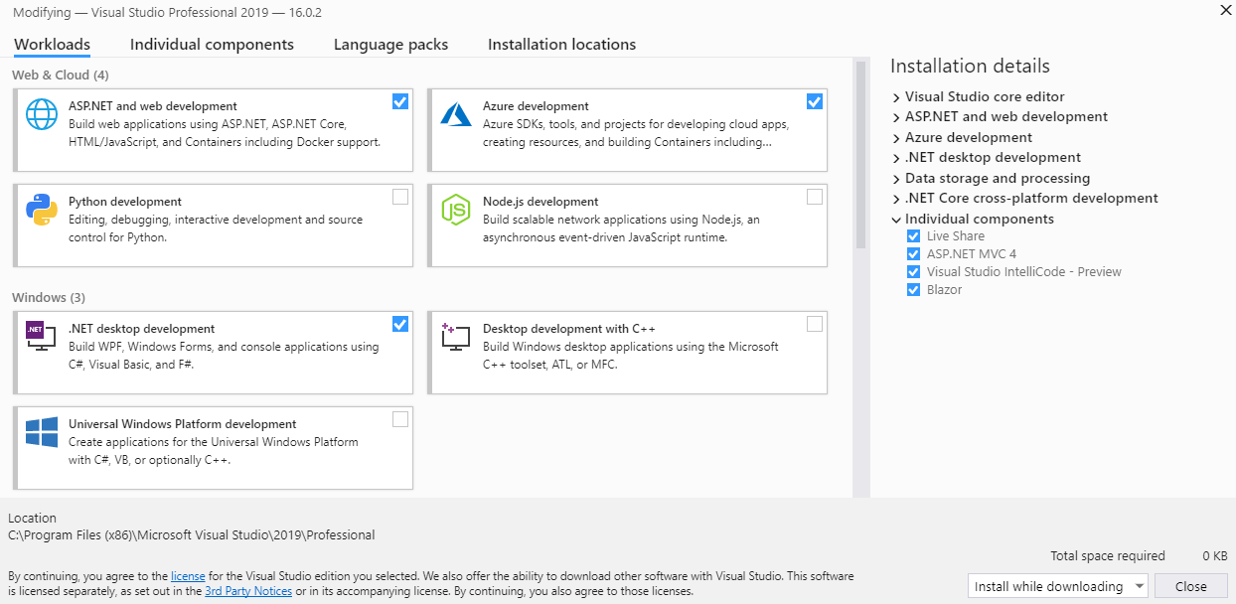
Smaller footprint…or not
Modular Installs

Slide 3
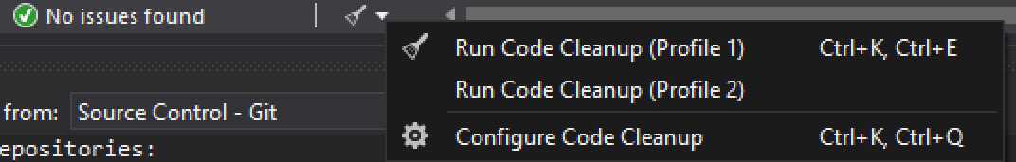
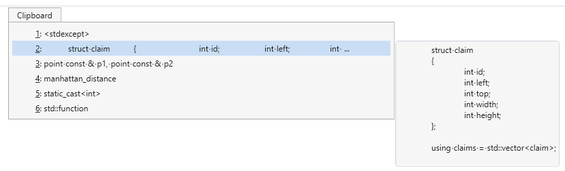
User Interface Updates
Help
Ctrl+Q
Code Cleanup
Clipboard Ring – Ctrl + Shift + V
Notes:
GetResponse on line 156

Slide 4
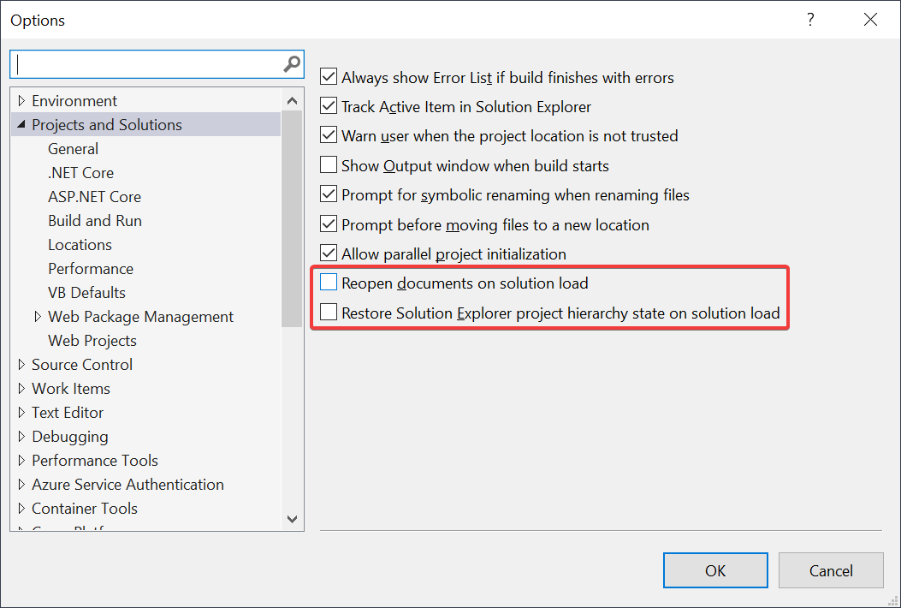
Restore Previous Session…or don’t
Tools > Options > Projects and Solutions > General

Slide 5

Document Health, Code cleanup, Debugger Improvements
https://youtu.be/9XE8kOI5JTk?t=169

Slide 6

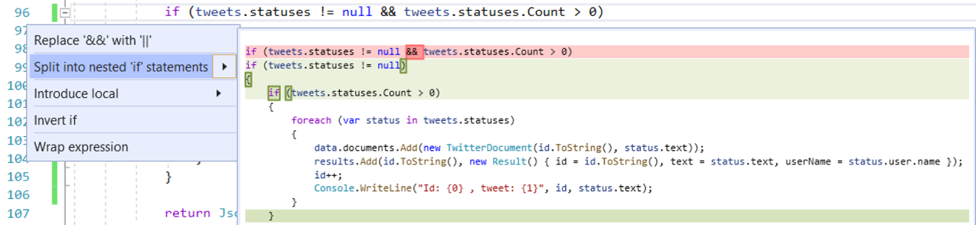
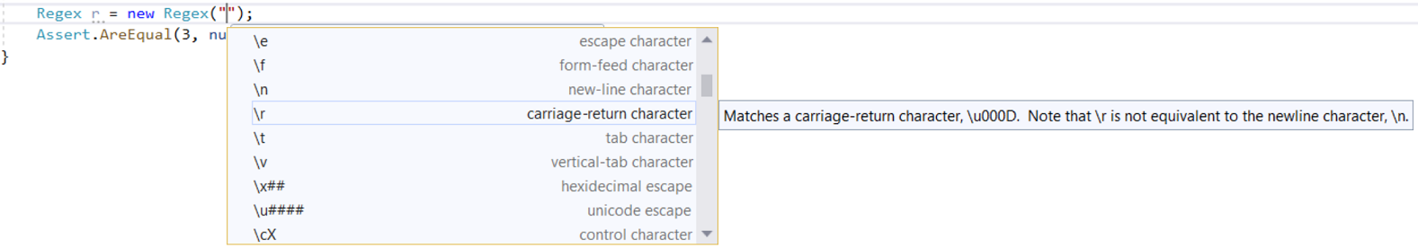
Is Resharper still worth it…
Split/Merge If Statements
Regex Help! (Ctrl + Space)

Slide 7
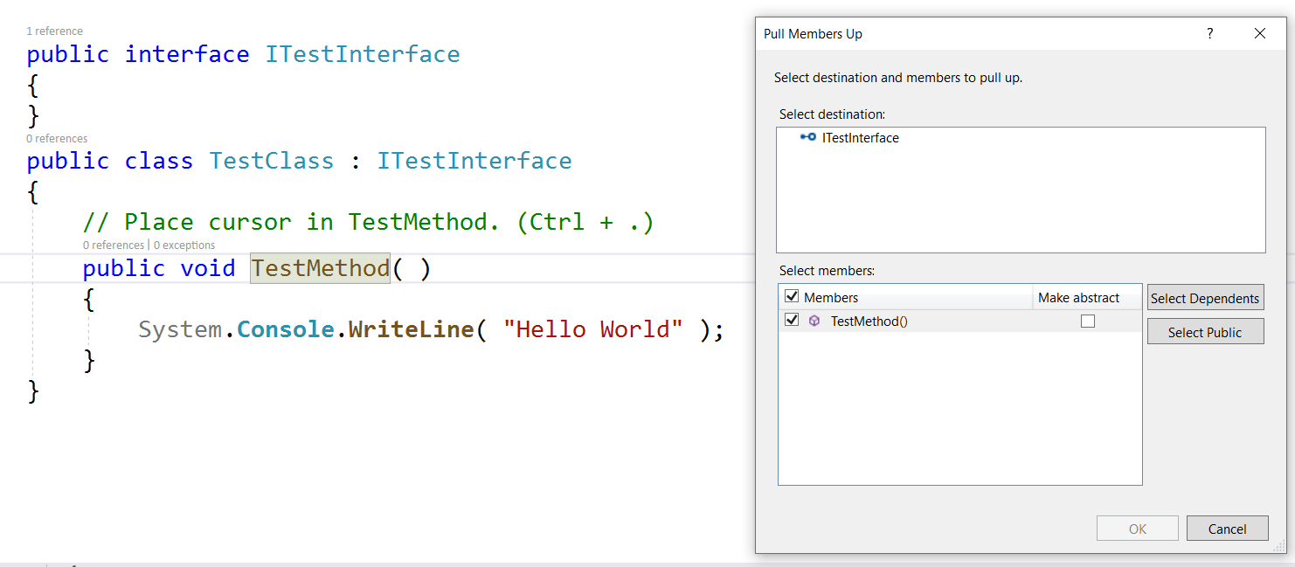
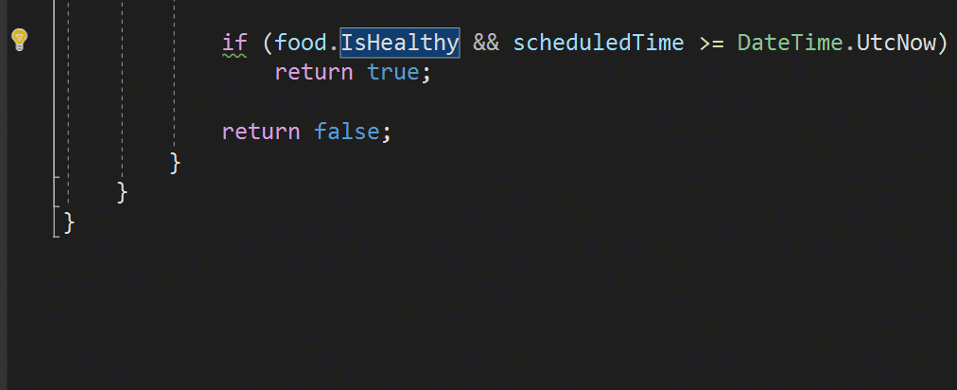
MOre
Here’s some more

Slide 8
Source Control / Debugging
Integrated Code Reviews
Data Breakpoints

Slide 9
Intellicode
Intellisense++
ReSharper and IntelliCode are not friends…

Slide 10

Visual Studio Live Share
https://youtu.be/9QXwSg9-2qQ

Slide 11
Xamarin
Smaller, Faster
The Xamarin workload is now just 7.69GB, a 2x reduction from Visual Studio 2017 version 15.9 and a 3x improvement over version 15.7.

Slide 12
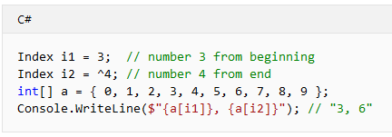
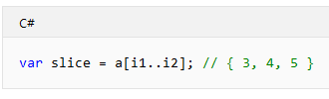
.NET Core 3.0
Index type Range type
Async streams
The IAsyncEnumerable<T> type is a new asynchronous version of IEnumerable<T>. The language lets you await foreach over IAsyncEnumerable<T> to consume their elements, and use yield return to them to produce elements.

Slide 13
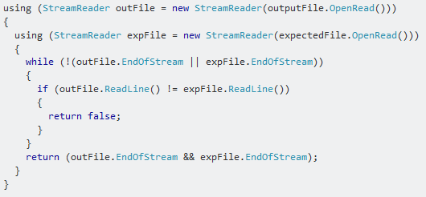
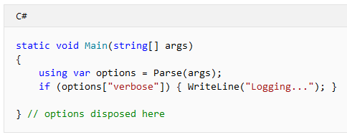
Old
New

Slide 14
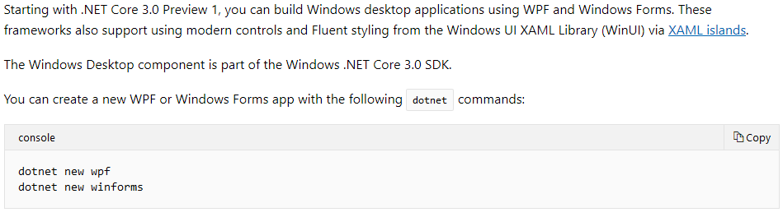
Windows Desktop apps
WPF, Windows Forms, XAML

Slide 15


Blazor
Live Demo

Slide 16
Sources
Slides will be available at: https://github.com/Kwen/sfdevs
https://docs.microsoft.com/en-us/visualstudio/releases/2019/release-notes-preview
https://mariusbancila.ro/blog/2019/01/04/a-first-look-at-visual-studio-2019/
https://oz-code.com/blog/honest-review-of-visual-studio-2019-preview-1/
https://docs.microsoft.com/en-us/visualstudio/releases/2019/release-notes
https://docs.microsoft.com/en-us/dotnet/core/whats-new/dotnet-core-3-0
https://marketplace.visualstudio.com/items?itemName=vsideversioncontrolmsft.pr4vs
https://marketplace.visualstudio.com/items?itemName=aspnet.blazor
https://devblogs.microsoft.com/visualstudio/little-great-things-about-visual-studio-2019/

